Slide 1

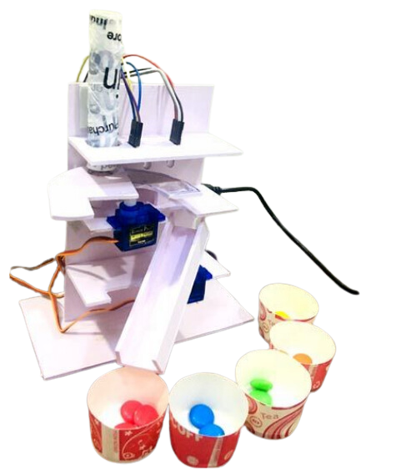


Group 4
Nguyễn Tuấn Tú
Trần Hoàng Tín
Nguyễn Tiến Đạt
Trần Thanh Hoài
Color-Based
Object Sorting Machine

Slide 2
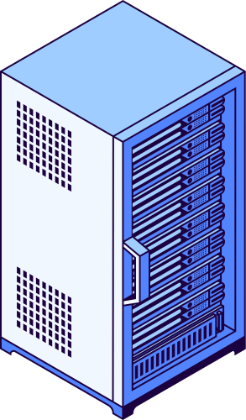
Group 4
Nguyễn Tuấn Tú
Trần Hoàng Tín
Nguyễn Tiến Đạt
Trần Thanh Hoài
Abstract
Color-based object sorting plays a crucial role in industrial automation, enabling fast and efficient classification of items based on their color properties. The proposed system detects object colors using a TSC34725 color sensor, Arduino Uno microcontroller, Bluetooth module, servo motor, LCD with I2C, and a buzzer to achieve seamless operation and real-time monitoring. This approach enhances automation efficiency in industries such as waste management, food processing, and packaging.

Slide 3



Group 4
Nguyễn Tuấn Tú
Trần Hoàng Tín
Nguyễn Tiến Đạt
Trần Thanh Hoài
Introduction
Automation has revolutionized industries by enhancing efficiency and precision. In many sectors, such as manufacturing and recycling, color-based object sorting plays a vital role in classification and quality control. Traditional manual sorting is often slow and error-prone, making automation a more effective solution.
A Color-Based Object Sorting Machine uses color sensors to detect object colors and a microcontroller to process the data, and sorting colors. This system improves speed, accuracy, and reduces human involvement.

Slide 4
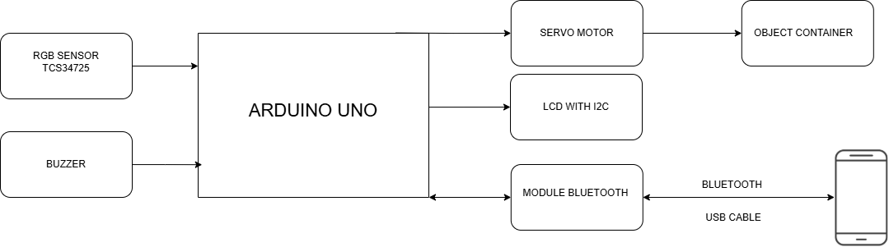
System Model & Block Diagram
Color Detection: The TSC34725 color sensor detects the color of an object placed in the sorting area.
Data Processing: The Arduino Uno processes the color data and determines the appropriate bin for the object.
Sorting Mechanism: The servo motor moves to direct the object to the correct bin based on the processed color data.
Display and Notification: The LCD displays the number of objects sorted and their colors. The mobile app provides real-time updates and notifications.
Control Modes:
Automatic Mode: The system sorts objects continuously until all objects are checked. Upon completion, the buzzer sounds, and a notification is sent to the mobile app.
Manual Mode: Users can specify a number of objects with a specific color on the mobile app. The system stops sorting, activates the buzzer, and sends a notification when the specified number is reached.

Slide 5
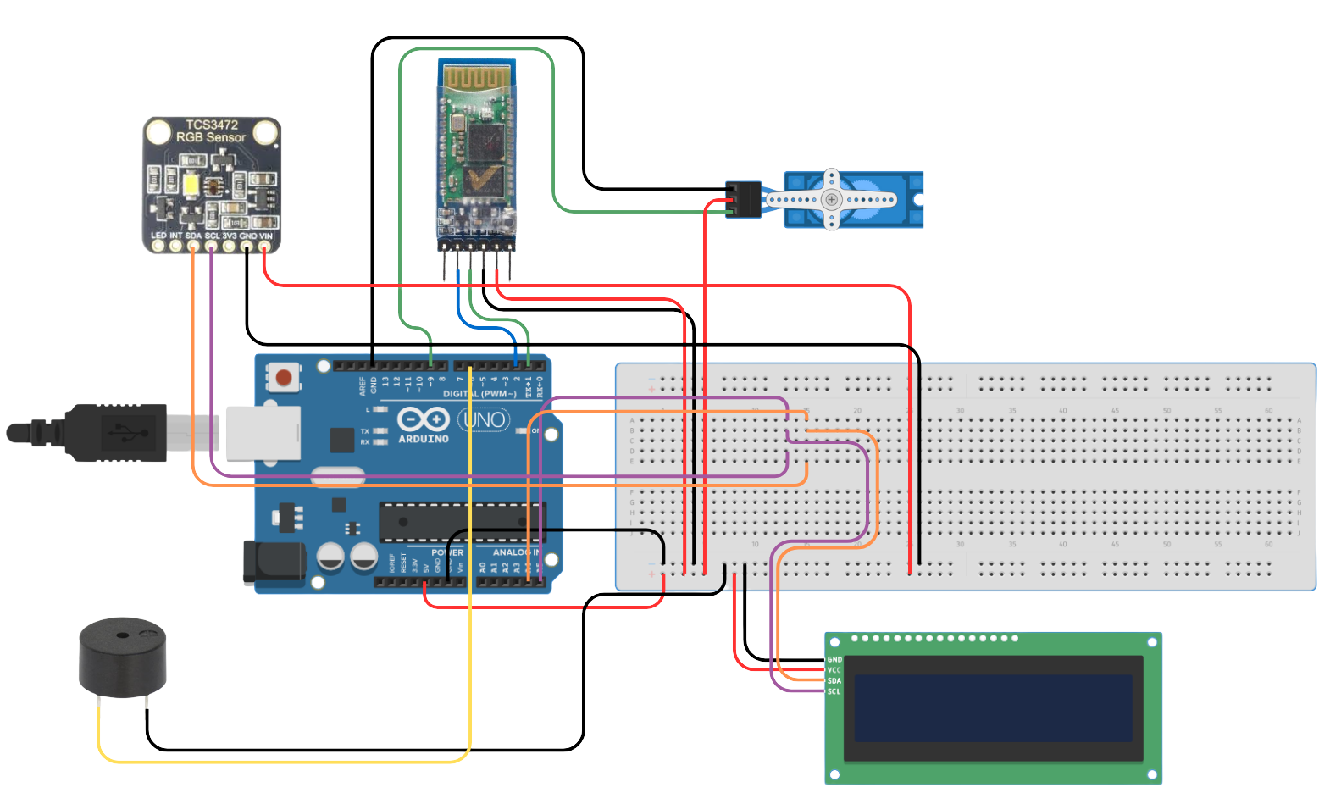

Slide 6
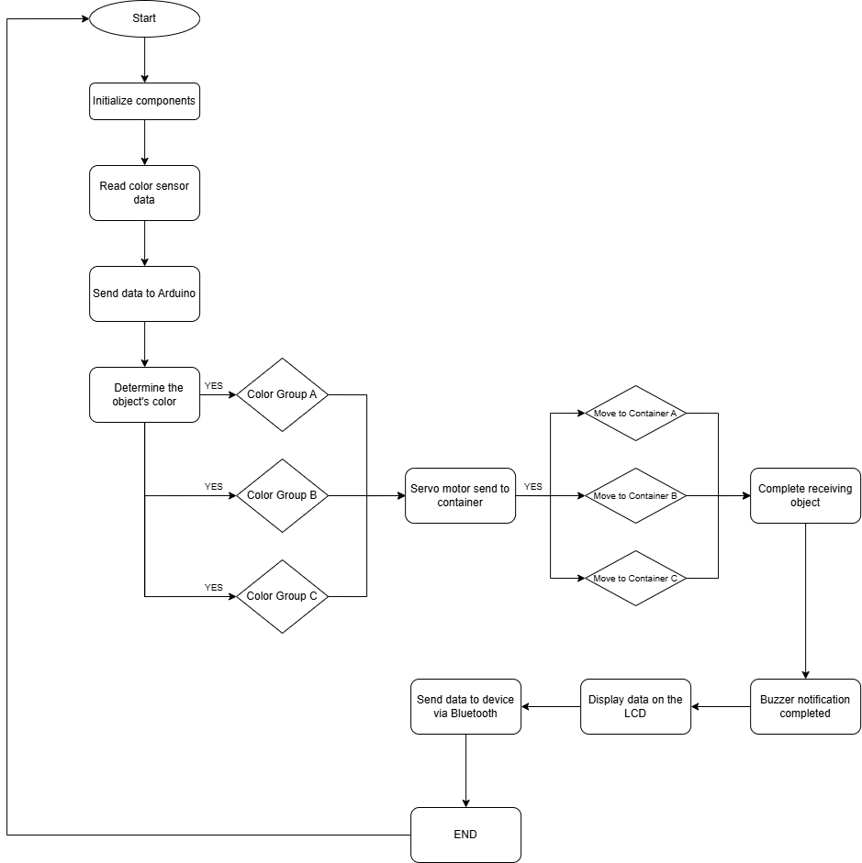

Slide 7
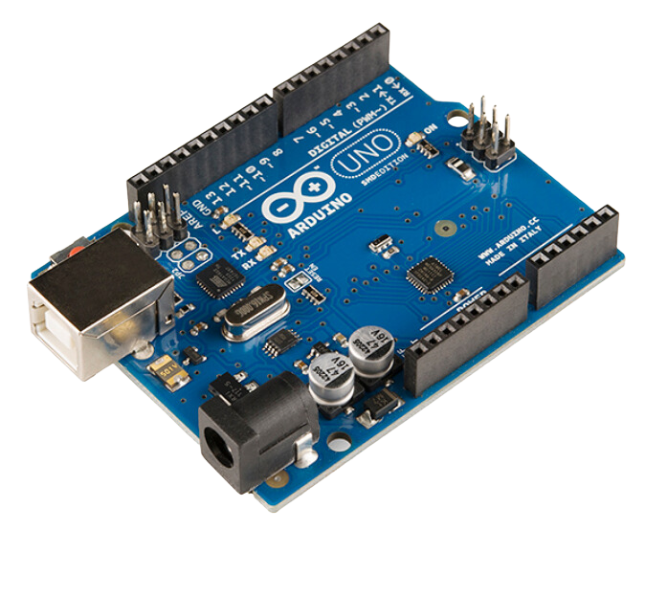
Group 4
Nguyễn Tuấn Tú
Trần Hoàng Tín
Nguyễn Tiến Đạt
Trần Thanh Hoài
Arduino Uno R3
Main Specifications:
Microcontroller: ATmega328P
Used for: Robotics, home automation, sensor-based systems
Supports: Digital & analog I/O, PWM, serial communication
Power & Connectivity
Power Supply: 7-12V (VIN) or 5V via USB
Pins:
Digital I/O: 14 pins (0-13, 6 support PWM)
Analog Inputs: 6 pins (A0-A5)
USB Port: For programming & power
Reset Button: Restart the board easily
Applications:
Prototyping electronic projects
Interfacing with sensors, motors, displays
Ideal for beginners & advanced users

Slide 8
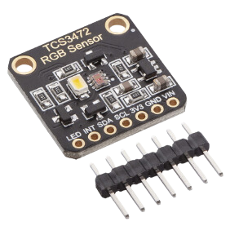
Group 4
Nguyễn Tuấn Tú
Trần Hoàng Tín
Nguyễn Tiến Đạt
Trần Thanh Hoài
TSC34725 Color Sensor
Main Specifications:
Function: Detects and measures RGB (Red, Green, Blue) and clear light
Applications: Color recognition, ambient light sensing, display calibration
Compatible with: Microcontrollers like Arduino, NodeMCU
Pin Configuration:
VCC: Connects to 3.3V or 5V power
GND: Connects to ground
SDA (Serial Data): Connects to the microcontroller's SDA pin
SCL (Serial Clock): Connects to the microcontroller's SCL pin
INT (Interrupt): Signals when light levels exceed set thresholds
LED: Controls onboard illumination (if available)

Slide 9
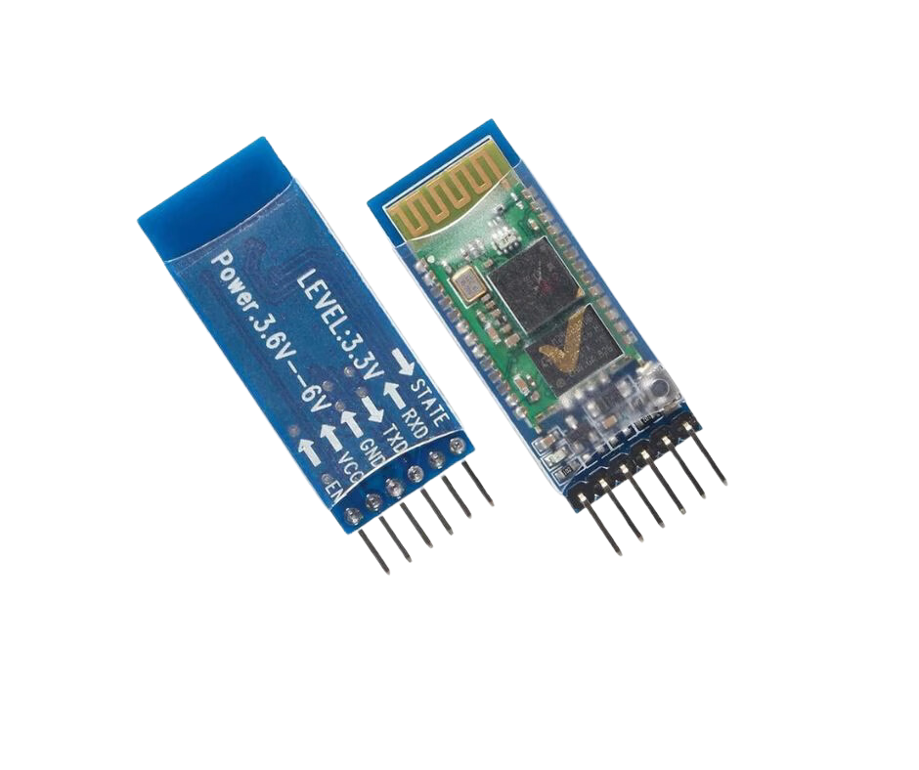
Group 4
Nguyễn Tuấn Tú
Trần Hoàng Tín
Nguyễn Tiến Đạt
Trần Thanh Hoài
Main Specifications:
Bluetooth Module HC-05
Operating Voltage: 3.3V - 5V
Operating Modes: Master & Slave
Range: Up to 10 meters
Default Password: 1234 or 0000
VCC, GND – Power supply.
TX, RX – Serial communication (UART).
EN/KEY – Mode configuration switch.
STATE – Connection status indicator.
Key Features:
Supports both master and slave modes
LED indicators for connection status
Supports serial communication with microcontrollers like Arduino, ESP32, and Raspberry Pi
Applications:
Wireless data transfer between microcontrollers
Home automation and IoT projects
Remote control systems
Wireless robotics and communication

Slide 10
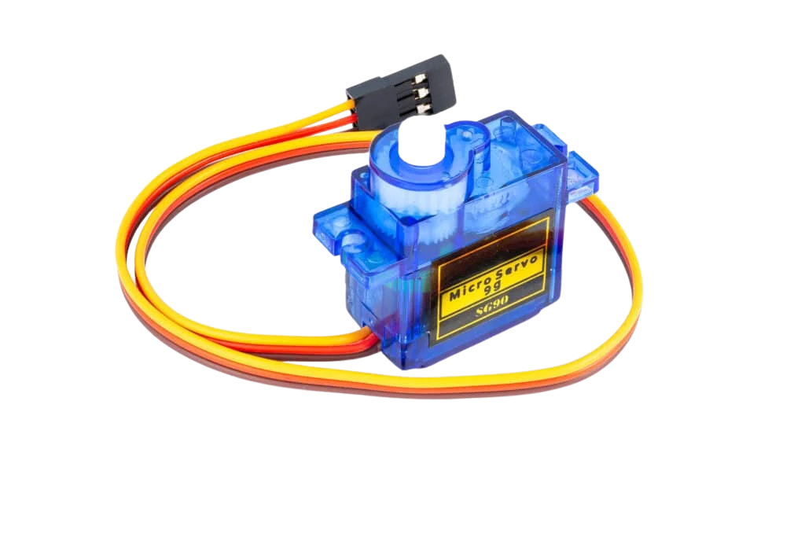
Group 4
Nguyễn Tuấn Tú
Trần Hoàng Tín
Nguyễn Tiến Đạt
Trần Thanh Hoài
Main Specifications:
Servo Moto
Operating Voltage: Typically 4.8V - 7.4V (depending on model)
Control Signal: PWM (Pulse Width Modulation)
Standard Seravo: 0° to 180°
Continuous Servo: 360° rotation
Response Time: Fast and precise positioning
Key Features:
Precise angular position control
Requires only one PWM pin for control
Available in standard (position control) and continuous rotation (speed control) types
Compatible with microcontrollers like Arduino, ESP32, Raspberry Pi
Applications
Robotics and automation
RC cars, drones, and airplanes
Smart home projects (e.g., automated doors, camera gimbals)
Industrial automation and prosthetics

Slide 11
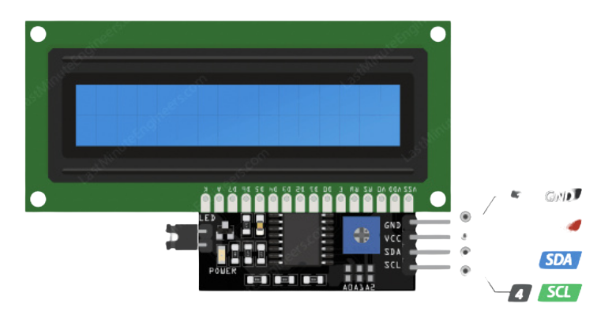
Group 4
Nguyễn Tuấn Tú
Trần Hoàng Tín
Nguyễn Tiến Đạt
Trần Thanh Hoài
LCD with I2C
Main Specifications:
Interface: I2C
Operating Voltage: 5V
GND – Ground pin (connects to Arduino's GND)
VCC – Power supply pin (usually 5V)
SDA – Serial Data Line for I2C (connects to Arduino's SDA, usually A4)
SCL – Serial Clock Line for I2C (connects to Arduino's SCL, usually A5)
Key Features:
Reduces the number of required microcontroller pins (only uses SDA & SCL)
Supports multiple I2C addresses for flexibility
Easy to use with libraries like LiquidCrystal_I2C in Arduino
Applications:
Displaying sensor readings
User interfaces for embedded systems
IoT and automation projects
Menu-based navigation systems

Slide 12
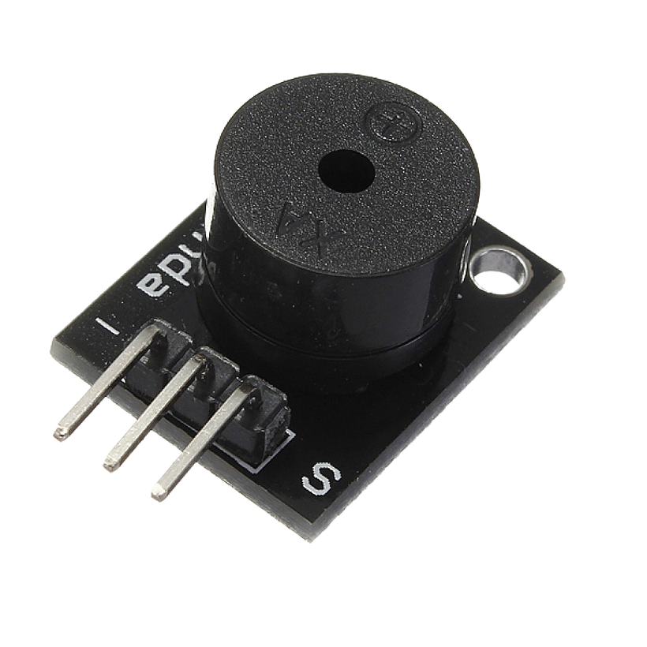
Group 4
Nguyễn Tuấn Tú
Trần Hoàng Tín
Nguyễn Tiến Đạt
Trần Thanh Hoài
Buzzer
Main Specifications:
Operating Voltage: Typically 3V - 12V
Current Consumption: ~5mA - 30mA
Sound Level: ~85dB at 10cm
VCC (+) – Power supply (3.3V - 5V)
GND (-) – Ground (GND)
I/O (Signal) – Receives control signal (from a microcontroller like Arduino)
Key Features:
Simple control with digital HIGH/LOW (Active Buzzer)
Can generate different tones using PWM (Passive Buzzer)
Compact and low power consumption
Applications:
Alarms and security systems
Sound notifications in embedded systems
Timers and reminders
Electronic toys and smart home devices

Slide 13
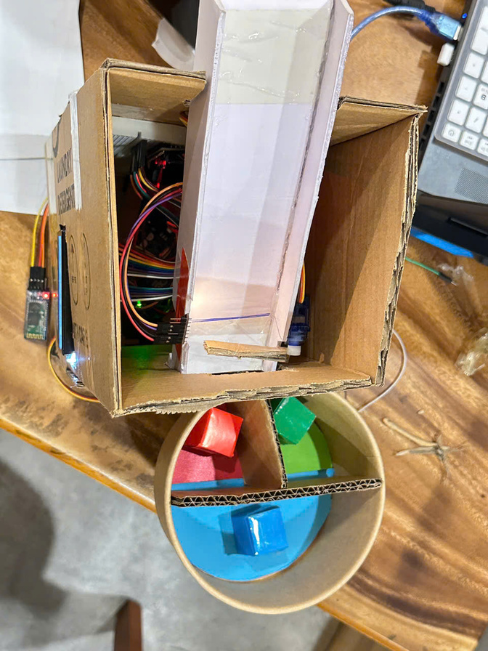
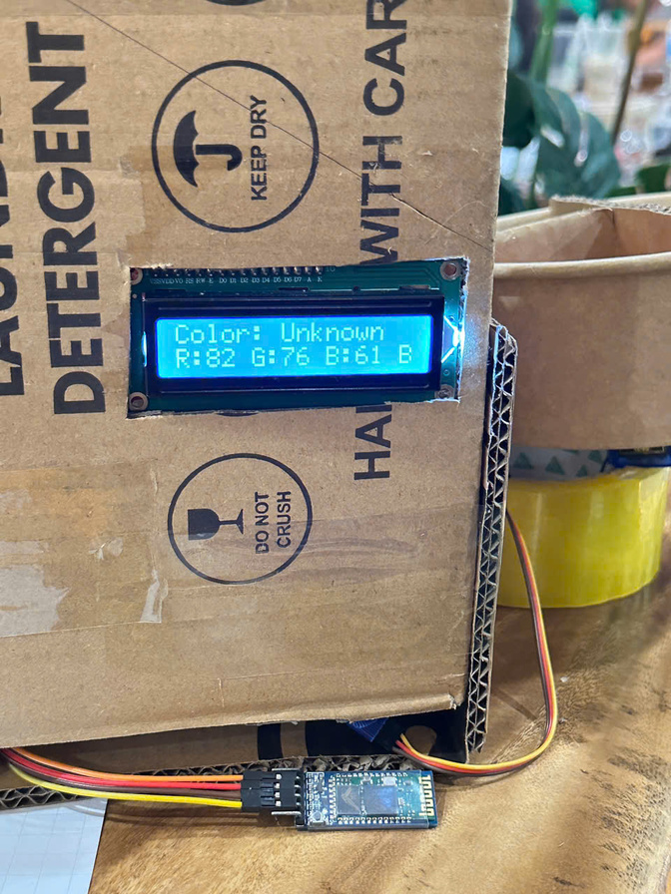
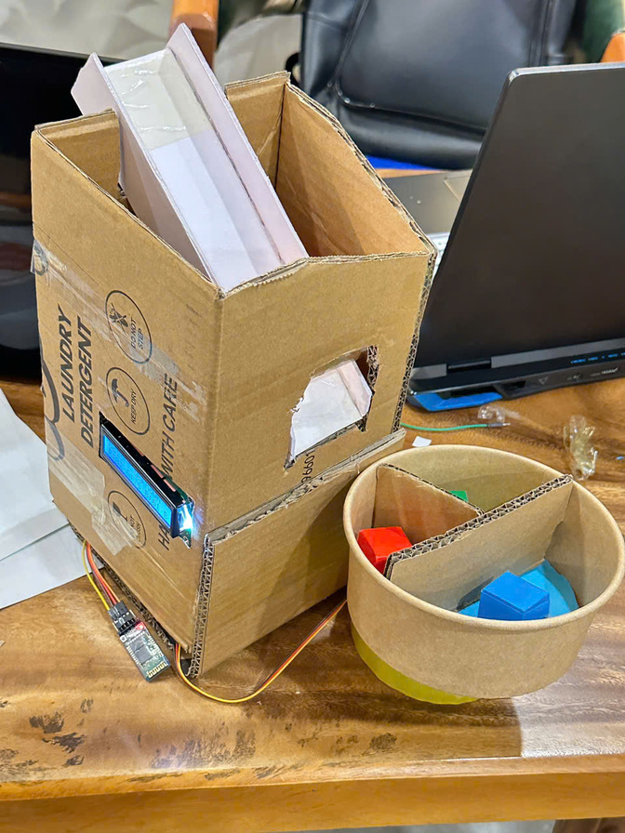
Group 4
Nguyễn Tuấn Tú
Trần Hoàng Tín
Nguyễn Tiến Đạt

Slide 14
Group 4
Nguyễn Tuấn Tú
Trần Hoàng Tín
Nguyễn Tiến Đạt
Trần Thanh Hoài
ID | NAME | Contribution
SE181760 | Nguyễn Tuấn Tú | 25% Program Bluetooth, Servo Moto, LCD with I2C, Buzzer, design, Write report and prepare Presentation
SE185022 | Trần Hoàng Tín | 25% Program Arduino, TSC34725 Color Sensor, Software Programing, design and prepare Presentation
SE184132 | Trần Thanh Hoài | 25% Abstract, Introduction, Software Programing, design and prepare Presentation
SE184970 | Nguyễn Tiến Đạt | 25% System Model and Block Diagram, Programing Flowchart, design and prepare Presentation

Slide 15
Group 4
Nguyễn Tuấn Tú
Trần Hoàng Tín
Nguyễn Tiến Đạt
Trần Thanh Hoài
Thank
You.
Thank
You.
Thank
You.

